Slide 1
Bayesian Decision Making in Biological Motion
The Encoders
Ankani Chattoraj Deepak Gopinath Khashayar Misaghian Albert Buchard Santiago Alonso-Diaz
Notes:
Soccer example. Information deprived stimulus. Take a look at this picture here. In psychophysics this is why point light walker models become important.
There are different hierarchies of information.

Slide 2


Slide 3
Objective
Determine the degree of contribution of local motion and dynamic form cues in deciding if a point-light walker moves to the left or right.

Slide 4
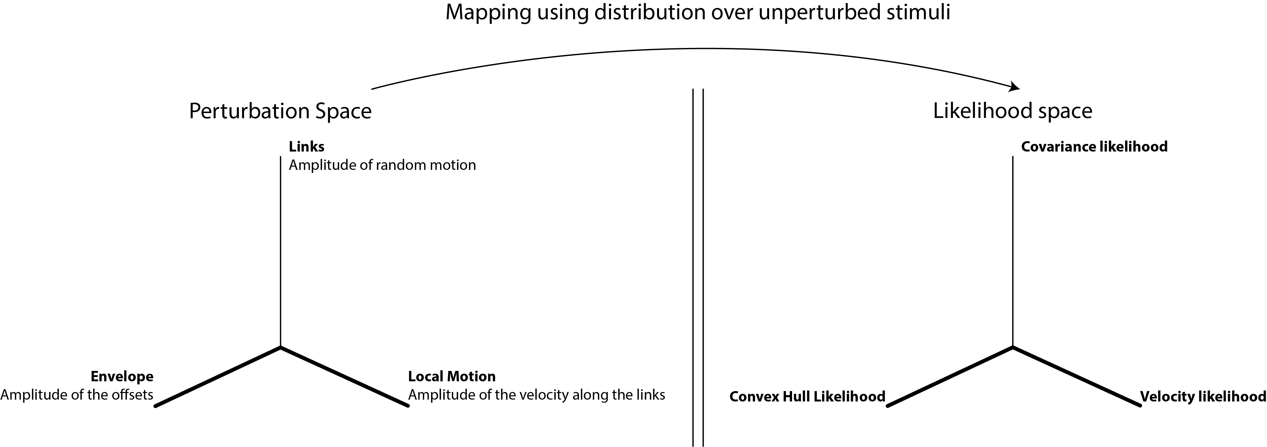
Stimuli generation

Slide 5
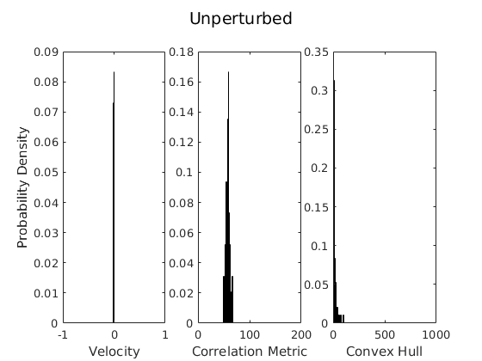
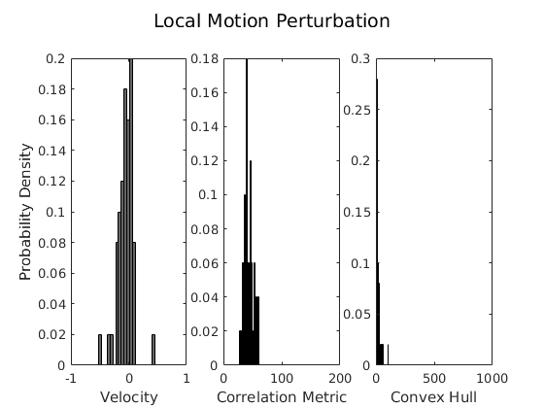
Stimuli generation

Slide 6
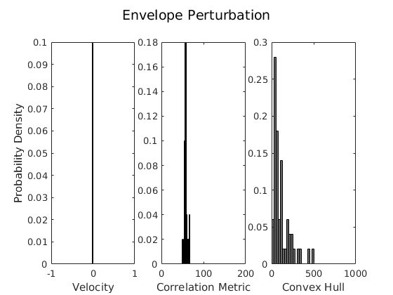
Stimuli generation

Slide 7
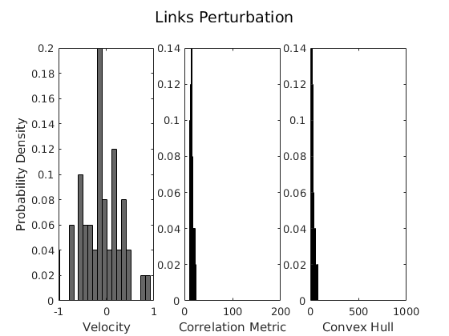
Stimuli generation

Slide 8
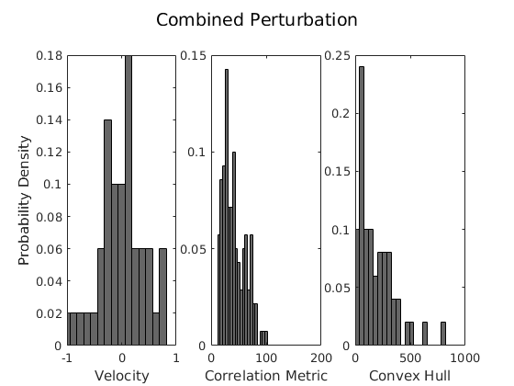
Stimuli generation

Slide 9
Background
Studies
Psychophysical
Neurophysiological
Functional Imaging
Experimental Data & Discoveries
Prominent Cortical areas

Slide 10
Background
Prominent Cortical areas
Dorsal pathway (motion) (Mather, Radford, & West, 1992)
Ventral pathway (form)
(Beintema & Lappe, 2002)
Beintema & Lappe
2002
Local Motion
Giese & Poggio
2003
Dynamic Form
Blake & Shiffrar
Combinations depending on cues
2007
Gilaie & Dotan
Lesion in Ventral Pathway capable of BM perception
2015

Slide 11
Hypotheses
Dynamic form and local motion combine to produce a decision.
However, recent work in patients with ventral damage indicate that form may not be a central cue (Gilaie-Dotan, et al, 2015, PNAS)
Dynamic form
Links
Decision (L or R)
Envelope
Local motion
Response time
Any perturbation to Dynamic Form, should affect behavior (e.g. accuracy) to a lesser extent than perturbations to Local Motion
Notes:
To dig deeper into this question we asked the more specific question of ….

Slide 12
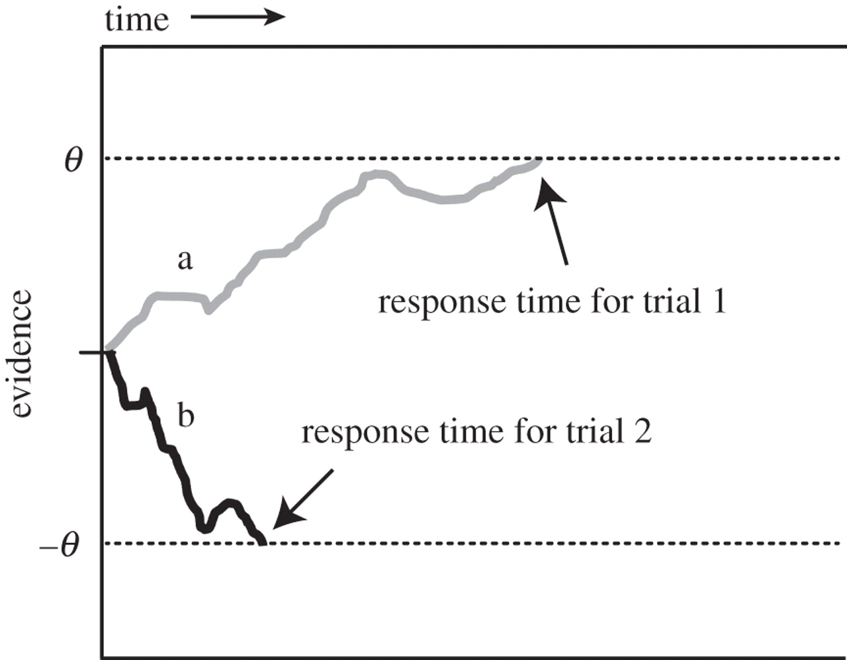
DDM: Accumulation of combined evidence
Bayesian drift diffusion model
Convex Hull (e)
Local Motion (m)
Links (l)
Parameters:
w = weights
k = sensitivity
θ = threshold
Allows us to investigate the role that each cue plays in biological motion perception.
Notes:
We used accumulation + cues that combine.
{\color{DarkRed} {\dot{x}} = sensitivy \times \sum_{cue} w_{cue}\cdot belief_{cue}(likelihood_{cue}(t)) }

Slide 13
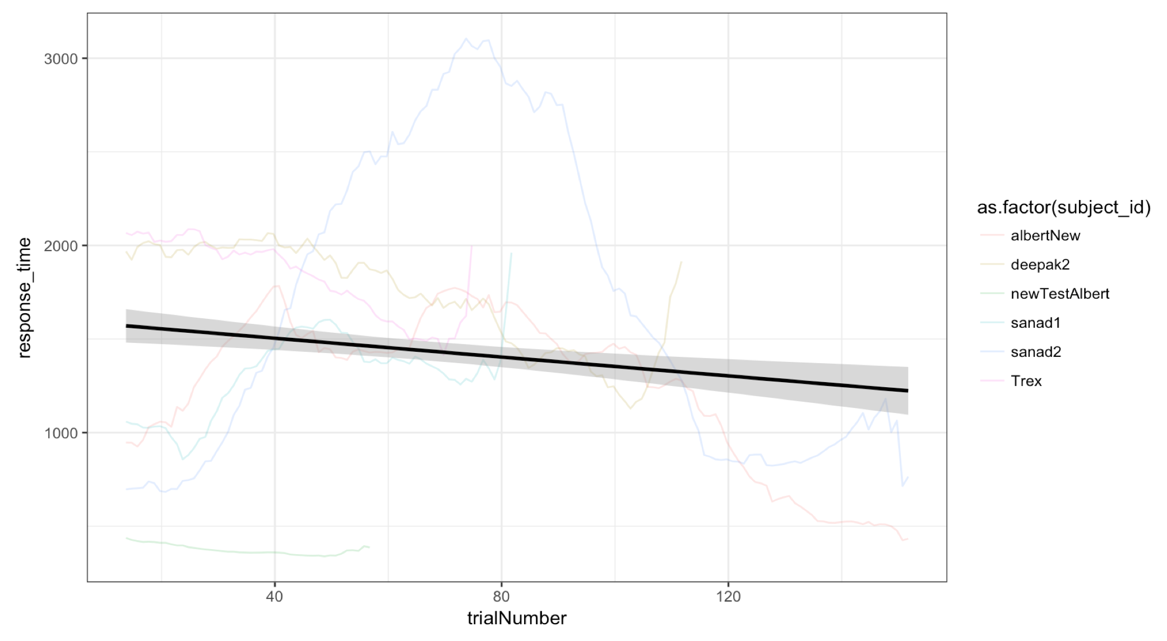
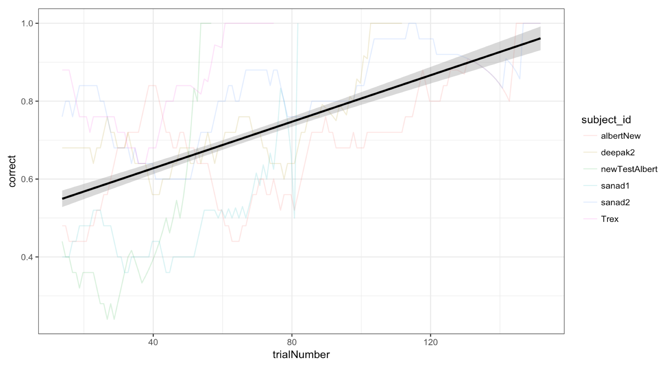
Behavior

Slide 14
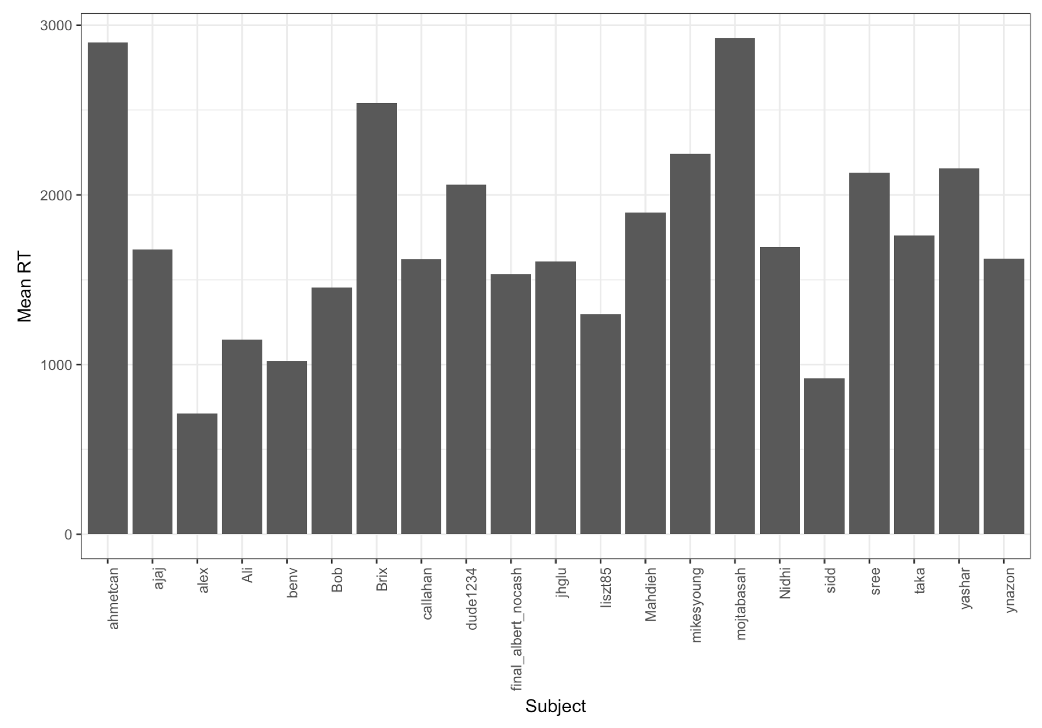
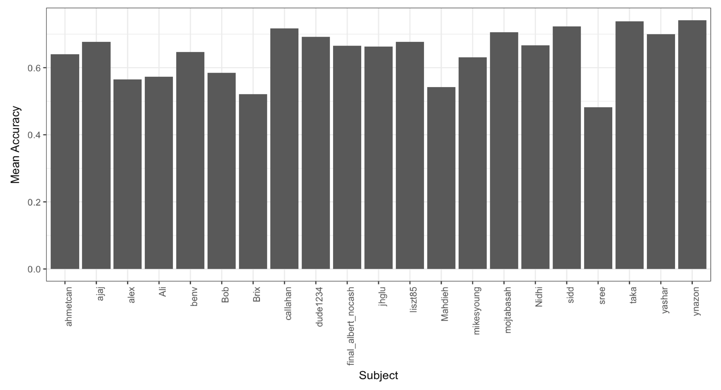
Behavior

Slide 15
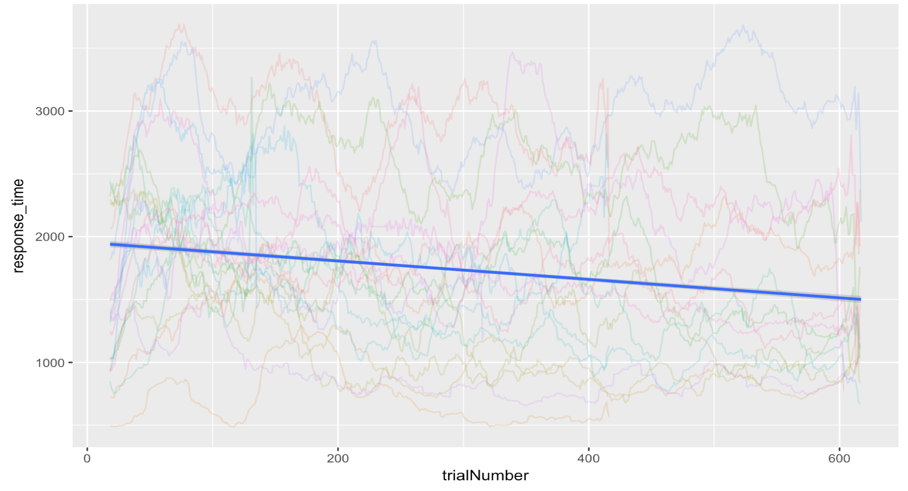
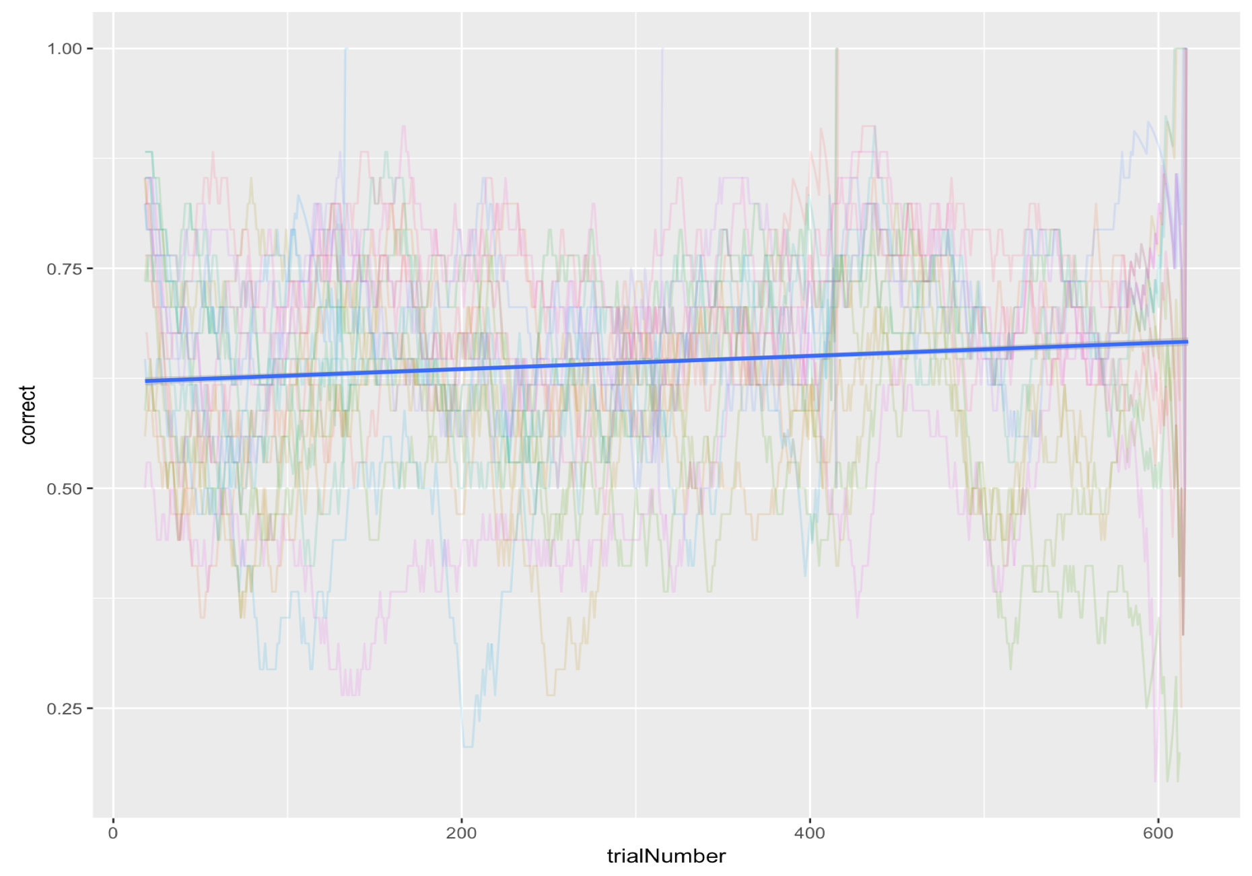
Behavior

Slide 16

Model testing re. hypotheses
Local motion is more important
Links are more important
Envelope is more important

Slide 17
Critical model evaluation
Simplifying assumptions:
Cues are independent
Individual points on the walker are sometimes detectable
Extension in future:
Test the model more specifically on human data
Test the model with dependent cue combination

Slide 18
Summary
We characterized a more inclusive notion of form.
There exists no thorough definition of form in the literature.
The model we chose can help us understand the different extent of contribution by each cue, as determined from the obtained weights.
Our model represents an effort to move from basic tasks (e.g. Random Dot Motion) to perceptual phenomena closer to real experiences.

Slide 19
Acknowledgments
Niko Troje at Biomotion Lab Queens University
Paul, Konrad, and Gunnar!
You guys!

Slide 20
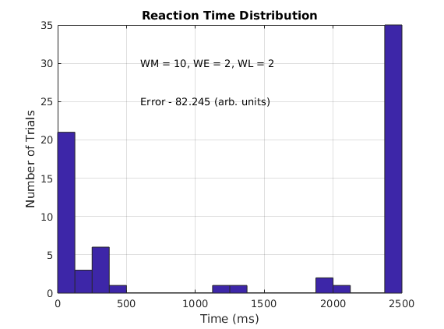
Preliminary Model testing
When
Motion cue is weightedmore
Envelope cue is weighted more

